Slide 1
GUIDED BY:
STUDENT NAME
YOUR NAME
YOUR NAME
PROJECT: MOVIE WEBSITE
COLLEGE LOGO HERE

Slide 2


ABSTRACT
WE HAVE DEVELOPED A WEBSITE WHICH WILL PROVIDE ALL LATEST MOVIES INFORMATION WITH THEIR TRAILERS. NOW IT IS OF VITAL THING IN PRESENT SCENARIO USER CAN GET ALL INFORMATION BEFORE DECIDING ANYTHING TO WATCH A MOVIE. THIS SITE PROVIDES THE ALL INFORMATION LIKE USER CAN EASILY GET ALL INFORMATION REGARDING LATEST MOVIES OR ITS GENERATION. MEMBERS CAN ALSO ASK QUESTION AND GET THE ANSWER REGARDING THEIR INTEREST FOR ANY SPECIFIC CATEGORIES OF MOVIES.
-02

Slide 3

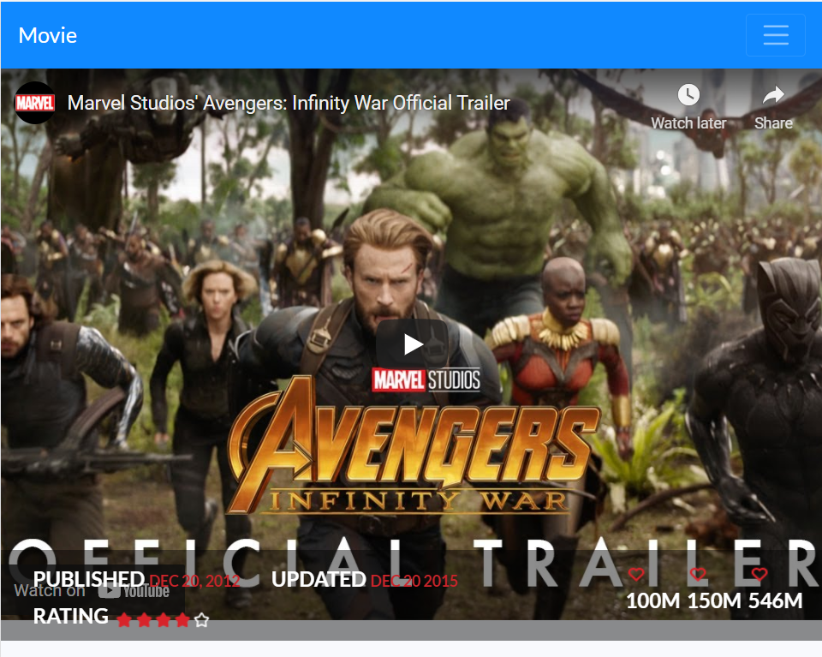
INTRODUCTION
In this website, we have included specific content on a site homepage like movie trailers, and you can simply get the information about latest movie release or top rated movies. Members need to register to the site to get complete access to the website and to get to know about latest movie releases and they can even watch their trailers.
03

Slide 4
PROBLEM DEFINITION
-04
Our main challenge was to give reason to stay on our website and look for his/her interest i.e. movies. So, we decided to provide as many as information like trailers, movie info and reviews.
This website contains a free membership access which provides benefits to the members like they can review the trailers or leave their feedback.

Slide 5
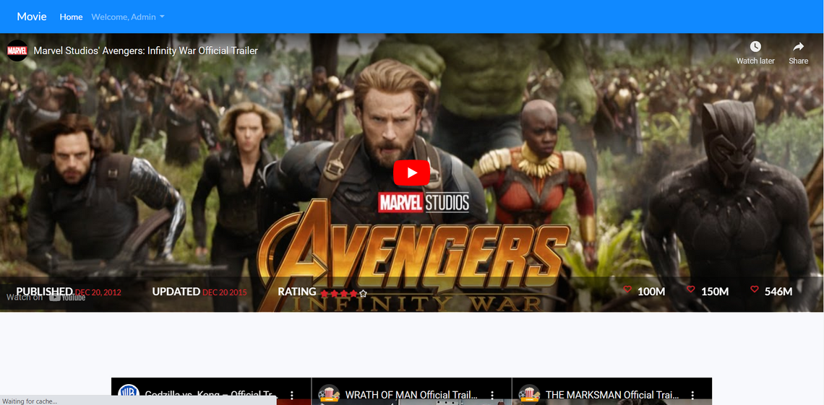
CONTAIN LATEST MOVIES INFO
SOLUTION
Movie website is a featured website designed specifically for movie lovers who seeks new movies info on the internet.
05
GIVE ACCESS TO MOVIE TRAILERS
To promote it further, we have added latest movie trailers so you members can see them directly without going anywhere.
MEMBERS REVIEWS
It also provides users a special feature of reviewing the trailers.

Slide 6
SITE MAP FOR MOVIE SITE
Home Page –including an introduction top movie trailer and its information, latest movie trailers & small description; with help, feedback and contact us form
Login & Registration Page – contain user information needed to subscribe as member and get full benefits. All fields are required to fill in the form.
The following site map has been used for designing and developing the website.
Profile Page –consists a member details like name, email, DOB, age etc. and user can edit profile as well.
06

Slide 7

-07
Technology used to develop the website
HTML5
CSS3
Bootstrap
JavaScript
jQuery

Slide 8
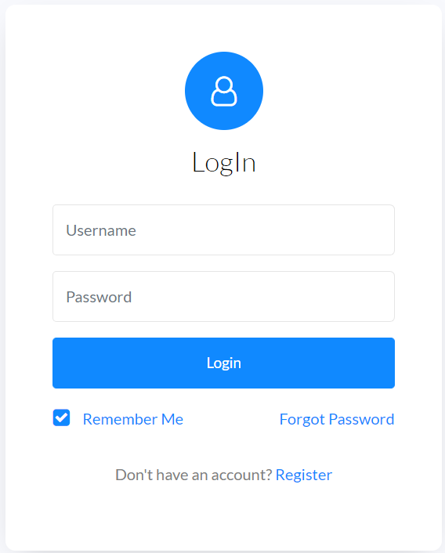
08
LOGIN & REGISTER
PAGE
It's mandatory for a member to register itself to become a member or login to access the website to gain full access.

Slide 9
09
HOME PAGE
Contains main information of the website like movie details and trailers with a feature to give reviews. This site is mobile responsive designed for mobile users.

Slide 10
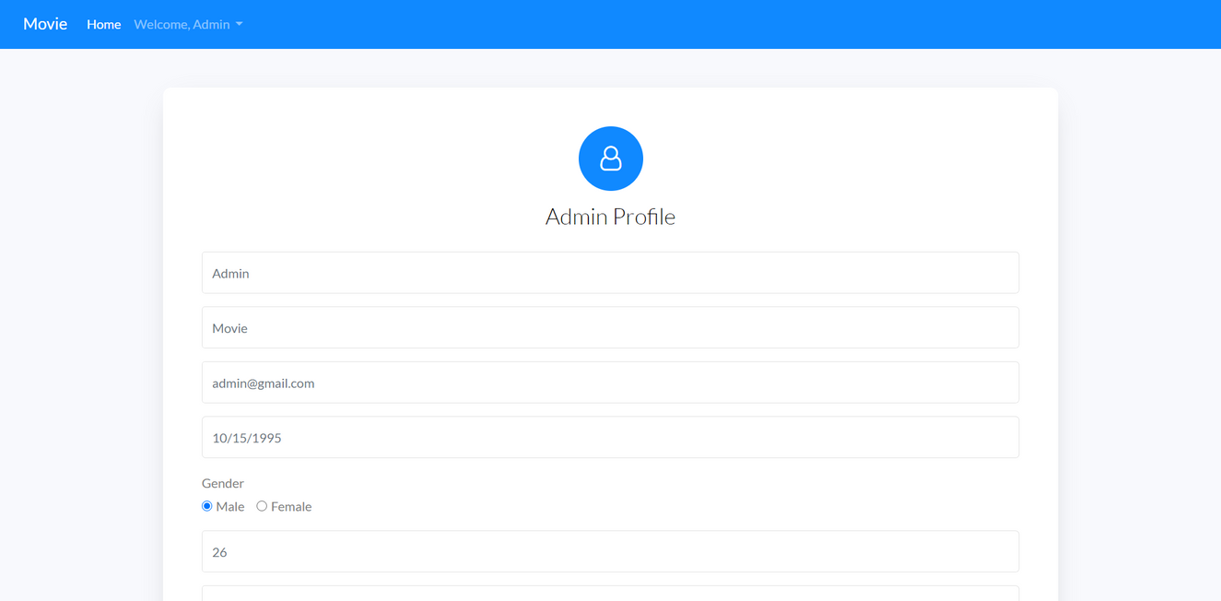
PROFILE PAGE
10
A member can edit or view his/her name, email, DOB, age etc.

Slide 11
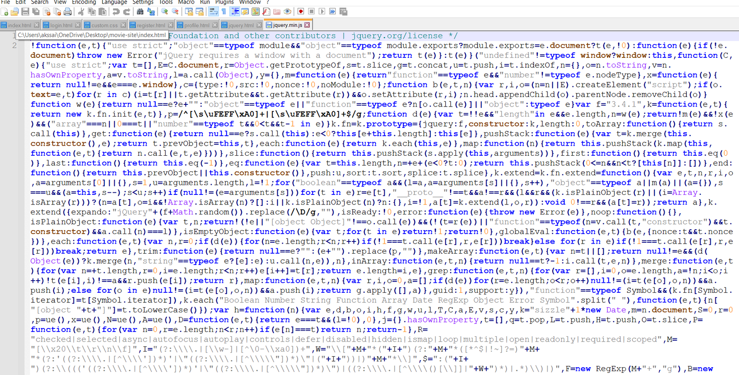
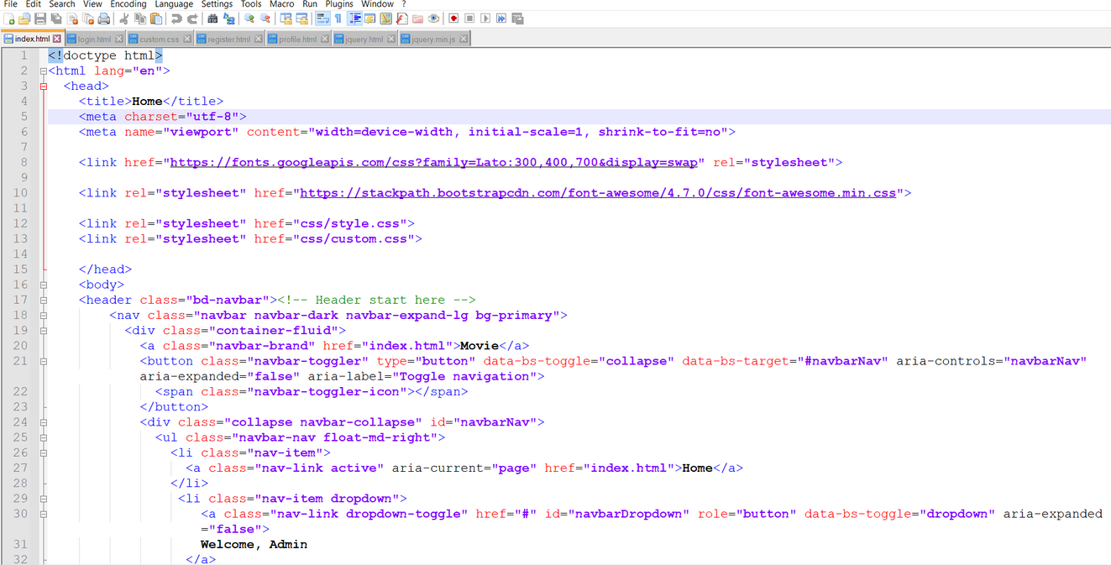
HTML & JQUERY CODE
11
Used HTML5/CSS3 & jQuery for site development

Slide 12
QUESTIONS? COMMENTS?
Feel free to share your feedback.

Slide 13
THANK YOU

